Slide 1
Income Prediction Challenge for Azubian
GROUP SYNDEY

Slide 2
INTRODUCTION

Slide 3
Group Members
David Anifowoshie
Gideon Dadzie
Fredrick Kwabena Boateng
Williams Elikplim George
Efobi Godwin

Slide 4
Within the context of developing nations, the stark imbalance in income distribution has assumed a prominent position, shrouding the future in a veil of ambiguity. Today, as we delve deeply into the core of this pivotal concern, we extend an invitation to you to join us on a voyage of discovery and pioneering solutions.
Our objective is unequivocal: to create a machine learning model with the ability to forecast an individual's income status, be it surpassing or falling below a specified threshold. This model will act as a guiding light, illuminating the path towards a future where we can address income inequality with precision and unwavering determination.

Slide 5
Project Structure
Business Understanding
Data Understanding
Data Preparation
Modelling
Evaluation
Deployment (using FastAPI)

Slide 6
DATA LOADING & DATA PREPROCESSING

Slide 7
The two essential datasets (train and test dataset) for this project was acquired on https://zindi.africa/competitions/income-prediction-challenge-for-azubian.
We employ the relevant libraries such as Pandas to import the data into our machine learning environment. This facilitates data manipulation and exploration.
To understand the data better, we also include a variable definitions dataset that provides insights into the meaning of each variable. It acts as a reference guide for data exploration and feature engineering.

Slide 8
Once the data is securely in our grasp, the next crucial step is data preprocessing. At this stage, the following activities were performed,
Handling Missing Values
Feature Engineering
Data Type Conversion
Class Imbalance
NaN Value Analysis
Validation Split
Data loading and preprocessing lay the foundation for our predictive machine learning journey.

Slide 9
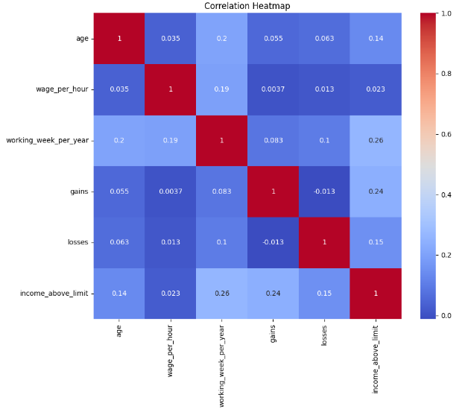
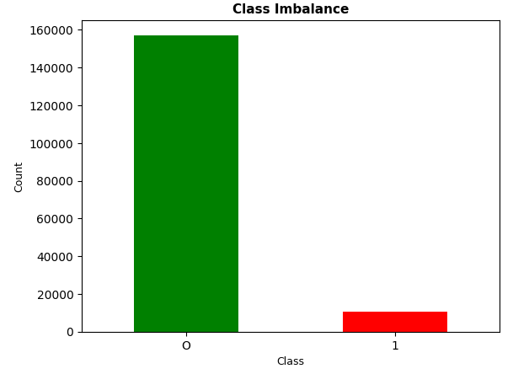

Slide 10
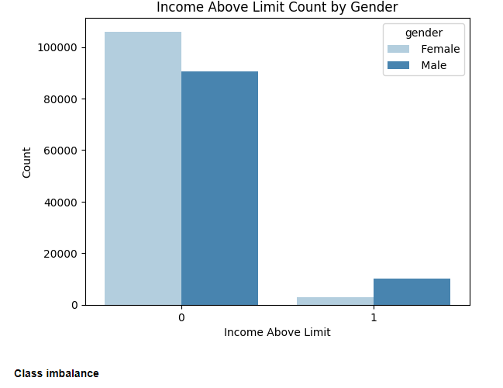

Slide 11
MODELLING AND MODEL EVALUATION

Slide 12
Model Selection
The heart of our project lies in choosing the right machine learning model to achieve our objective. For this purpose, we have opted for the CatBoostClassifier, a powerful algorithm well-suited for classification tasks.
CatBoostClassifier : We selected this model due to its remarkable capabilities in handling categorical features, implicit handling of missing data (NaN values), and quick establishment of a baseline model with minimal preprocessing.
Parameter Tuning: While adopting CatBoost, we also paid close attention to parameter tuning. Key parameters such as ‘n_estimators’, ‘max_depth’, ‘reg_lambda’, ‘reg_alpha’, ‘scale_pos_weight’, and ‘learning_rate’ were thoughtfully adjusted to optimize model performance.

Slide 13
Model Evaluation
Evaluating Accuracy: Our evaluation process commences with the computation of our model's accuracy on a validation set. This initial assessment offers a fundamental gauge of how correctly our model performs overall.
Classification Reports: To gain deeper insights into our model's effectiveness, we make use of classification reports. These comprehensive reports unveil vital performance metrics, including precision, recall, and the F1-score, for both the training and validation datasets. In situations marked by class imbalance, these metrics provide valuable insights into our model's capacity to accurately classify the minority class.

Slide 14
Fine-Tuning Thresholds: Recognizing the complexities presented by imbalanced data, we adopt a distinctive strategy. We adjust the probability threshold, optimizing the F1-score—a metric of particular relevance to our project. This adjustment enables us to enhance our model's performance, particularly in accurately classifying the minority class.

Slide 15
Quarterly performance

Slide 16
Business opportunities are like buses. There's always another one coming.
“
”
Richard Branson

Slide 17
Summary
At Contoso, we believe in giving 110%. By using our next-generation data architecture, we help organizations virtually manage agile workflows. We thrive because of our market knowledge and great team behind our product. As our CEO says, "Efficiencies will come from proactively transforming how we do business."

Slide 18
Thank you
Mirjam Nilsson​
mirjam@contoso.com
www.contoso.com

Slide 19
How we get there
ROI
Niche Markets
Supply chains
Envision multimedia-based expertise and cross-media growth strategies
Visualize quality intellectual capital
Engage worldwide methodologies with web-enabled technologies
Pursue scalable customer service through sustainable strategies
Engage top-line web services with cutting-edge deliverables
Cultivate one-to-one customer service with robust ideas
Maximize timely deliverables for real-time schemas

Slide 20


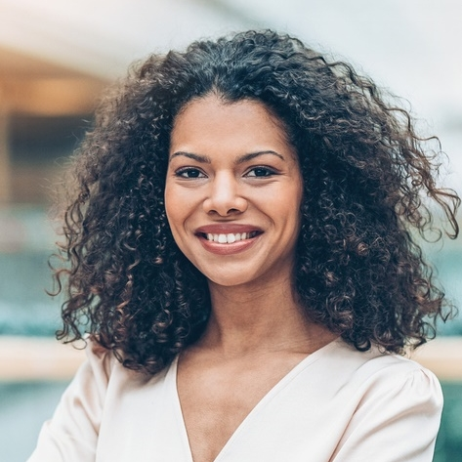

Meet our team
Takuma Hayashi
Mirjam Nilsson
President
Chief Executive Officer
Flora Berggren
Rajesh Santoshi
Chief Operation Officer
VP Marketing

Slide 21
Timeline
Deploy strategic networks with compelling e-business needs
Sep 20XX
Synergize scalable e-commerce
Nov 20XX
Disseminate standardized metrics
Jan 20XX
Coordinate e-business applications
March 20XX
Foster holistically superior methodologies
May 20XX

Slide 22








The full team
Takuma Hayashi
Mirjam Nilsson
Flora Berggren
Rajesh Santoshi
President
Chief Executive Officer
Chief Operations Manager
VP Marketing
Graham Barnes
Rowan Murphy
Elizabeth Moore
Robin Kline
VP Product
SEO Strategist
Product Designer
Content Developer

Slide 23
Areas of growth
 | B2B | Supply chain | ROI | E-commerce
Q1 | 4.5 | 2.3 | 1.7 | 5.0
Q2 | 3.2 | 5.1 | 4.4 | 3.0
Q3 | 2.1 | 1.7 | 2.5 | 2.8
Q4 | 4.5 | 2.2 | 1.7 | 7.0

Slide 24
Areas of focus
B2B market scenarios
Cloud-based opportunities
Develop winning strategies to keep ahead of the competition
Capitalize on low-hanging fruit to identify a ballpark value
Visualize customer directed convergence
Iterative approaches to corporate strategy
Establish a management framework from the inside

Slide 25
Introduction
Our objective is unequivocal: to create a machine learning model with the ability to forecast an individual's income status, be it surpassing or falling below a specified threshold. This model will act as a guiding light, illuminating the path towards a future where we can address income inequality with precision and unwavering determination.

Slide 26
Project Structure
Deploy strategic networks with compelling e-business needs
Data Understanding
Synergize scalable e-commerce
Marketing
Disseminate standardized metrics
Design
Coordinate
Foster holistically superior methodologies
Launch
Strategy
e-business applications
Launch
Deploy strategic networks with compelling e-business needs
1
2
3
4
5

